Slide 1
Fundamental studies on BN Materials: the role of h-BN and BNNT as supports for TMOx catalyst in CO oxidation.
Md Ashraful Islam
Ph.D. student
Materials Science and Chemical Engineering
Stony Brook University

Slide 2
Research Objectives
Understanding the physicochemical properties of metal oxide supported on h-BN catalyst.
Synthesize TMOx-hBN catalyst using OP-CVD method(TM= Co, Ni, Cu, Fe).
Finding the relations between the Dispersion and Distribution of metal nanoparticles on h-BN support.
h-BN and BNNT support effect on the catalytic performance of TMOx catalyst on CO oxidation.

Slide 3
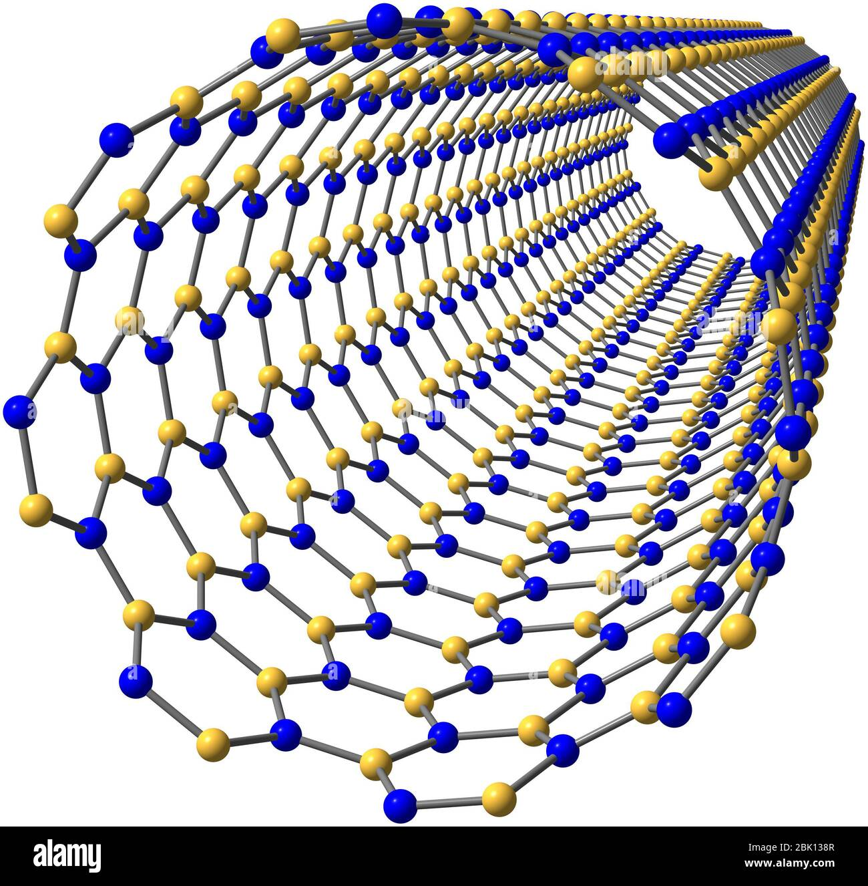
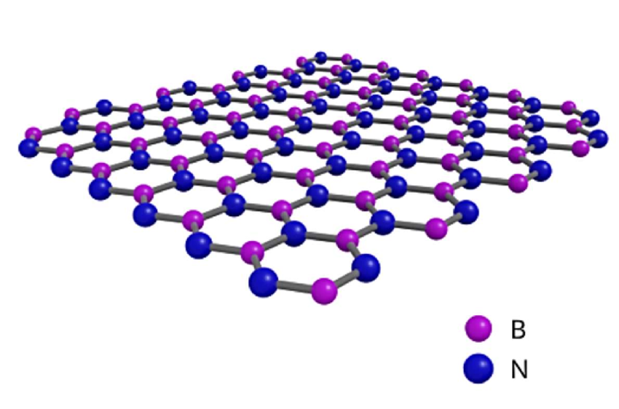
Introduction
High Oxidation resistance ( starts oxidation at 950-1000 ⁰C in air).
High thermal conductivity and stability (stable up to 800 ⁰C in air).
Excellent mechanical strength (Young modulus 1.1-1.3 TPa).
High Band Gap (around 5 eV) makes BNNT electrically insulating material.
Suitable for high temperatures and hazardous environments applications.

Slide 4
Comparison Between BNNT and hBN
Similarity
Both materials are made up of boron and nitrogen atoms.
They are considered chemically stable due to the strong B-N bonds.
Both BNNT and hBN exhibit excellent thermal conductivity.
Difference
BNNT - tubular nanotubes; hBN - flat, layered sheets.
BNNT - one-dimensional; hBN - two-dimensional.

Slide 5
Application of our research
CO oxidation is a core reaction in catalytic converters used in vehicles. It converts toxic CO in exhaust gases into non-toxic CO₂.
Treatment of CO emissions from chemical plants, power plants, and refineries.
Catalytic filters remove CO from enclosed air to ensure human safety.
Applications: BNNT - potential for nanoelectronics, composites, and drug delivery; hBN - lubricants, thermal management, and electrical insulation

Slide 6
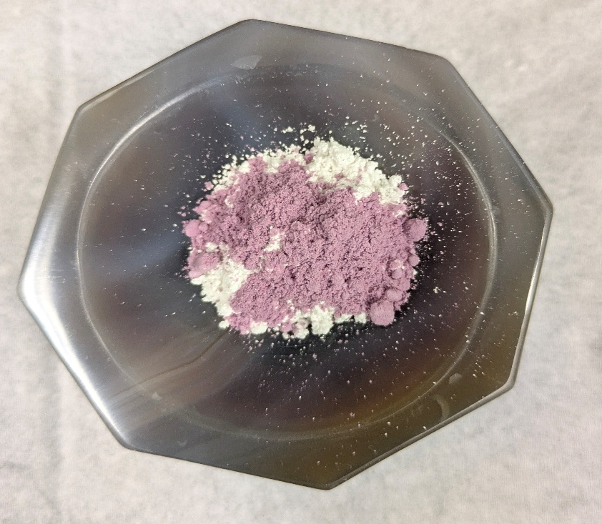
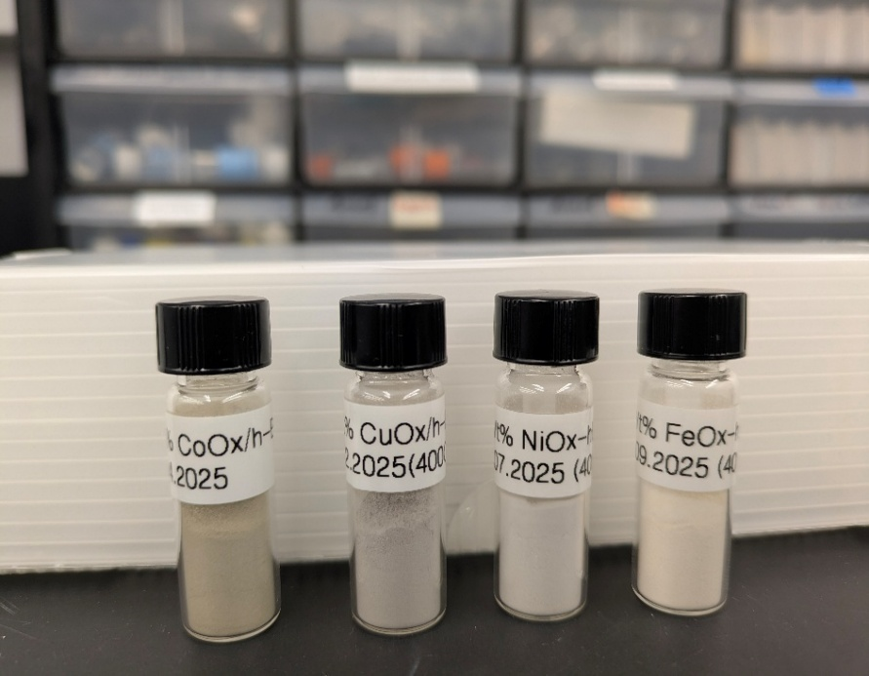
Experimental Section
Synthesize Catalyst by the OP-CVD method
Activity test
Characterization

Slide 7
Use of different Python libraries in our research.
Data handling and Extraction by Pandas
Numerical Operations by numpy
matplotlib.pyplot for Plotting data.
Interpolation and Curve Fitting
Numerical Integration

Slide 8
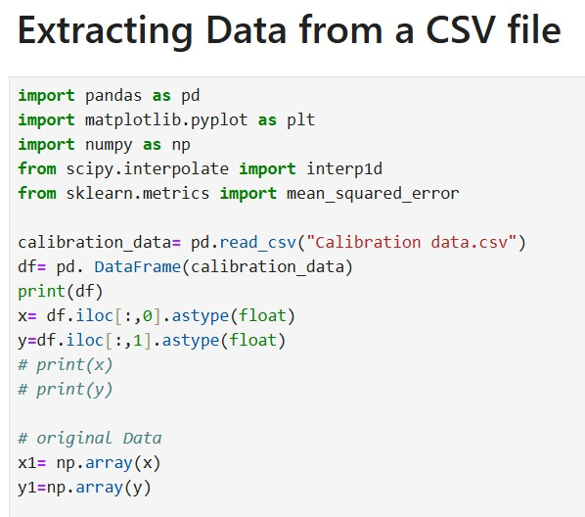
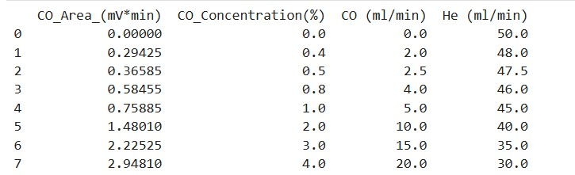
Reading data from a CSV file

Slide 9
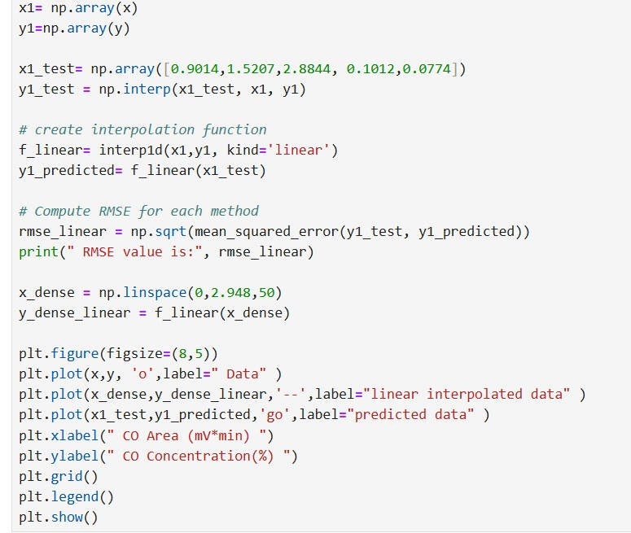
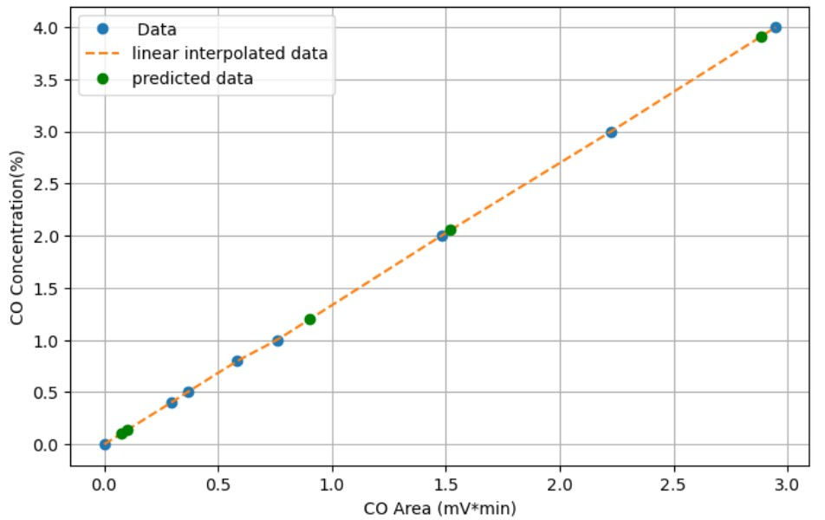
Plotting data and developing a Calibration Curve.

Slide 10
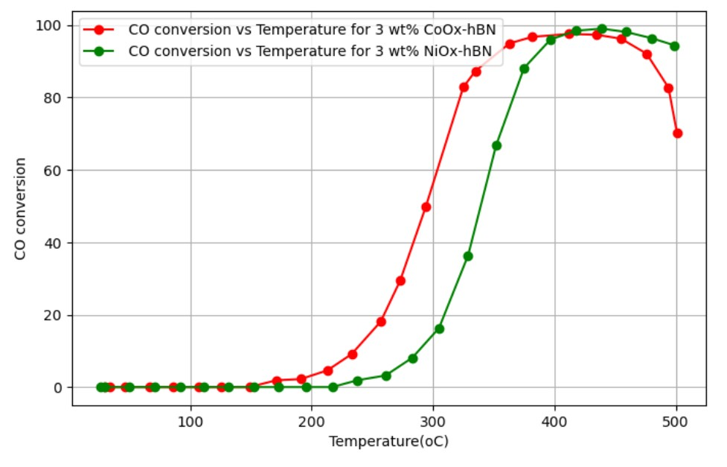
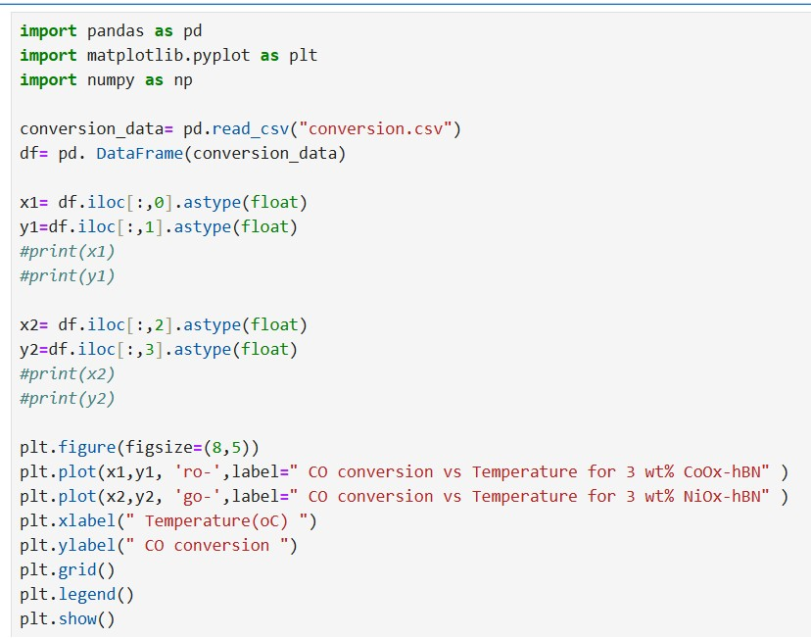
Plotting CO conversion vs Temperature graph

Slide 11
Determining Reaction Order using the Integral Method.
For determining the reaction order of
CO + O₂= CO₂
We need to plot different Concentration Vs Time data and match the best-fitted data with a linear line.
Concentration Vs Time for Zero Order.
ln[Concentration] vs time for 1st order reaction.
1/[Concentration] vs t for 2nd order reaction.

Slide 12
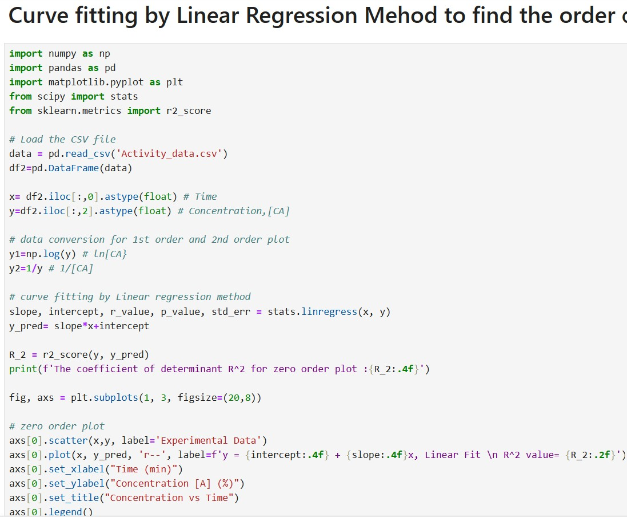
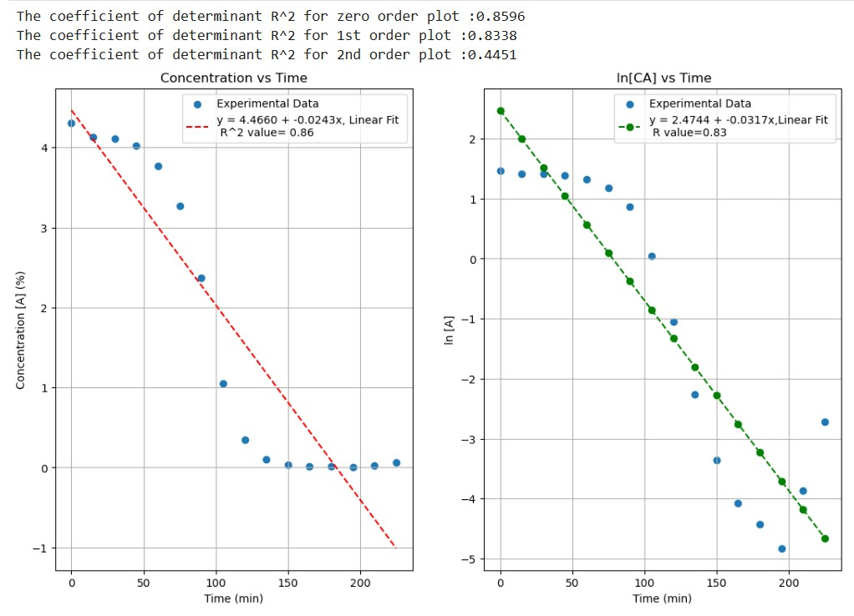
Determining Reaction Order using the Integral Method.

Slide 13
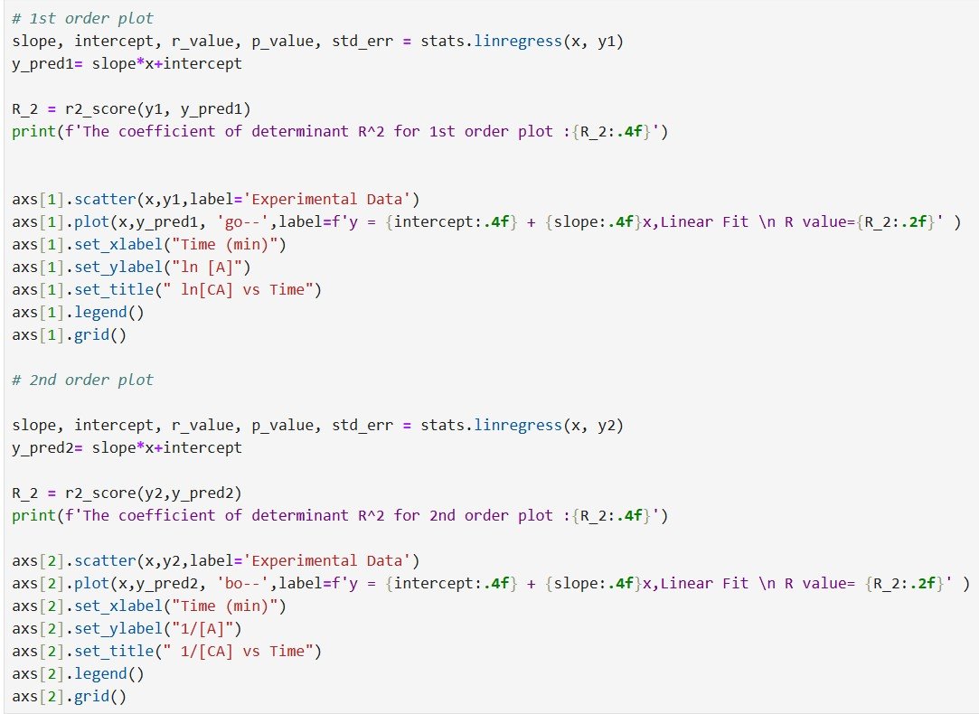
Determining Reaction Order using the Integral Method.

Slide 14
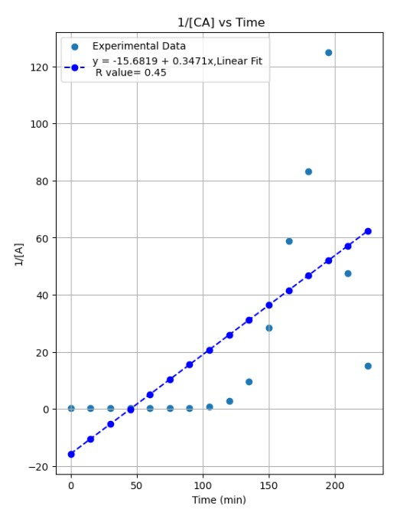
Determining Reaction Order using the Integral Method.

Slide 15
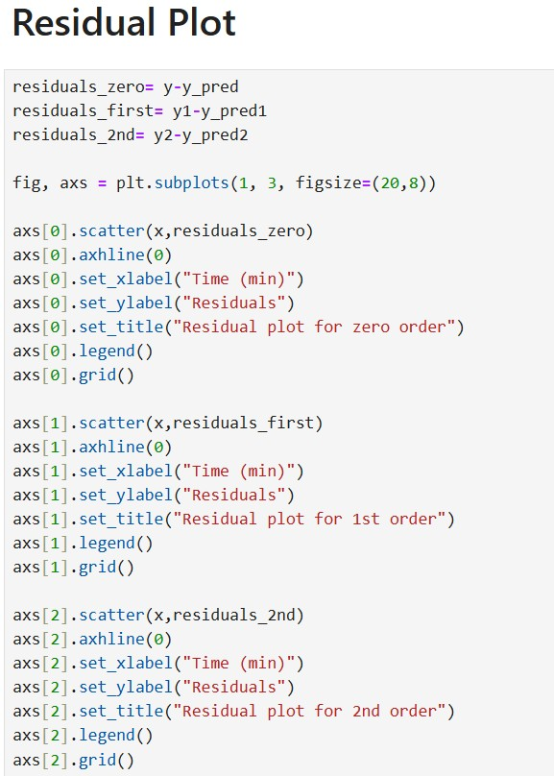

Slide 16
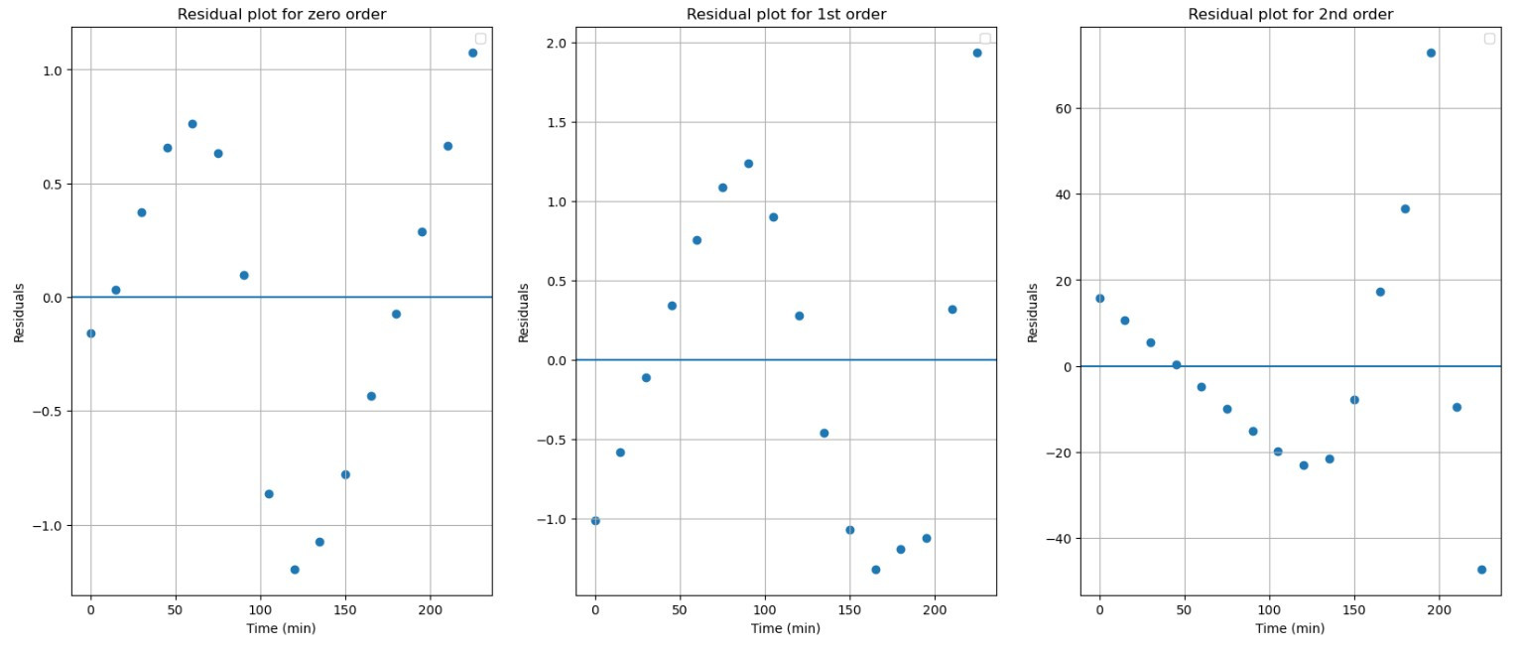
Residual Plots
For a zero-order plot, C_{A} vs Time, the Residual values are spread within +1 to -1 range. The residual values for 1st order plot are spread 2 to -1, while for 2nd order, these values are spread between -40 to 60. Residual plot for zero order shows the least deviation concerning other plots.

Slide 17
Determining Reaction Order using the Integral Method.
Results
Concentration Vs Time plot is fitted the most compared to the other two plots with an R² value of 0.86 for Zero Order.
Residual plot for zero order shows less deviation than other plots.
Hence, the order of CO oxidation over 3wt% CoOx-hBN catalyst is zero order with respect to CO.
The value of the Rate Constant K is 0.0243 mol/min

Slide 18
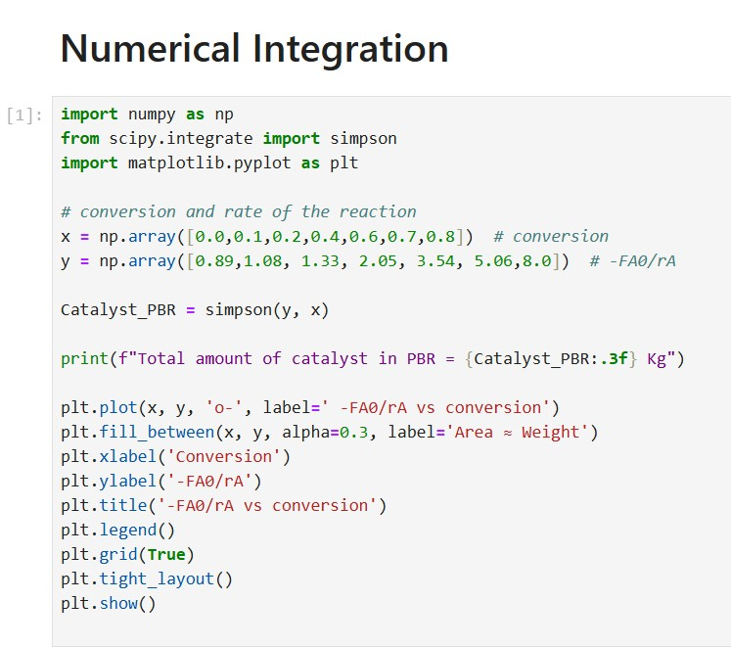
Calculating the Amount of Catalyst in PBR by numerical Integration.
Plot F_{A0}/r_{A} vs Conversion, x
To calculate the area under the curve, we need to use Numerical Integration method.
Using the Simpson method, we calculated the area.
This area is the required amount of catalyst for 80% conversion in PBR.

Slide 19
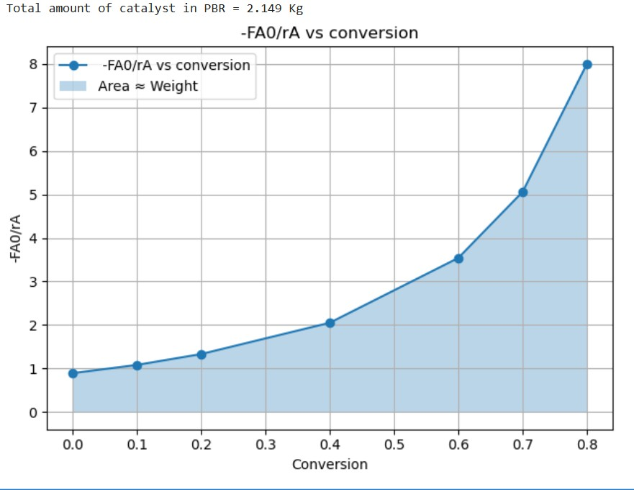
Calculating volume of PFR by numerical Integration.

Slide 20
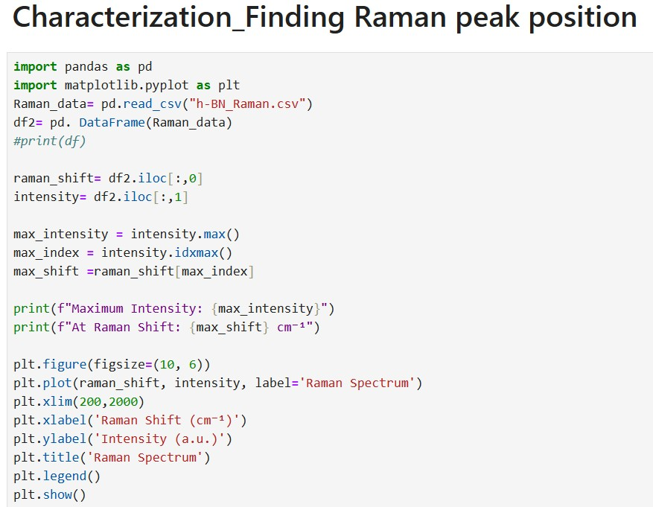
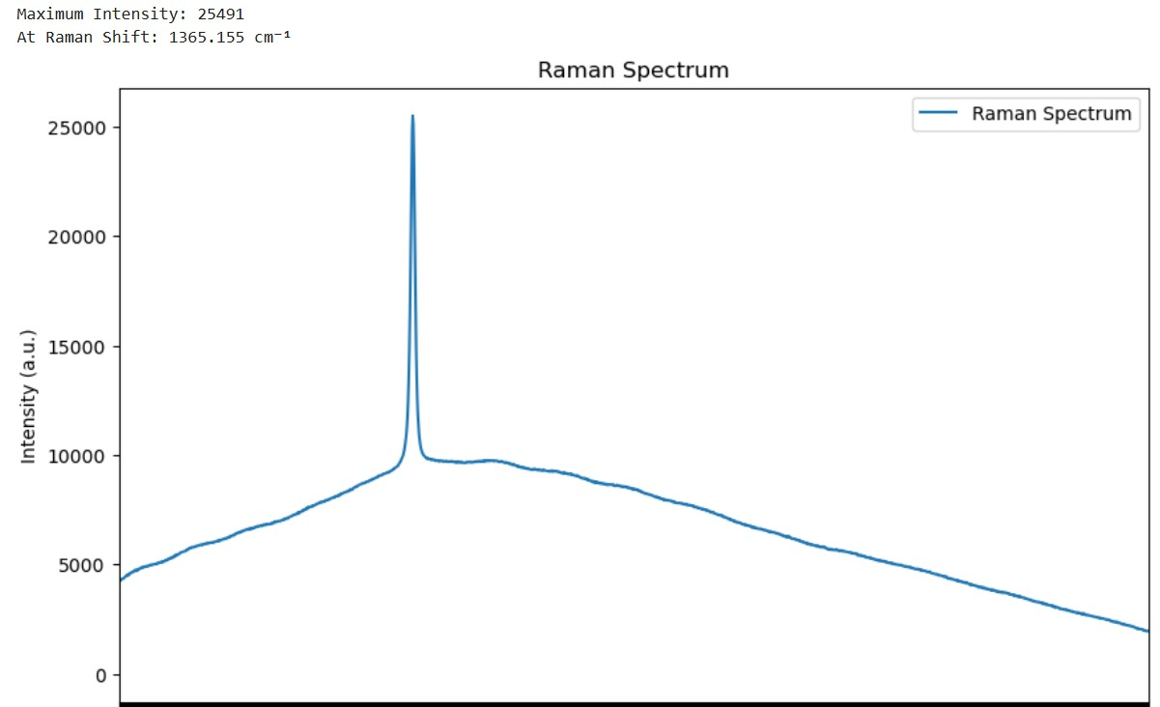
Characterization_Raman Spectra analysis.

Slide 21
Conclusion
Python helped to handle my experimental data and complete calculations easily.
It is useful for visualizing data in numerous ways.
Solving ODEs and numerical integration to calculate reactor volume and amount of catalyst by Python is helpful for my research.

